Slide 1
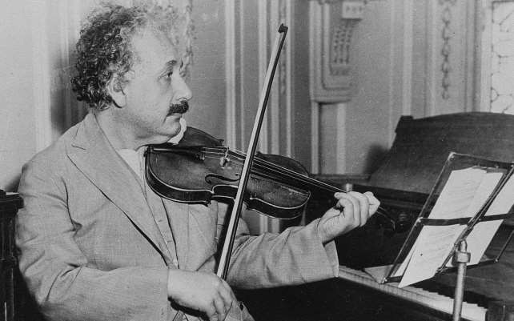

Class IX Prose
A Truly Beautiful Mind

Slide 2
THEME
This brief sketch of the life and achievements of the great genius Albert Einstein, reveals that extraordinary personalities with exceptional intellectual capabilities are not necessarily noticed during the early years. The author focuses on two aspects of Einstein’s personality –as a scientist and as a human being . As a scientist , his marvellous discoveries created a revolution and as a human being, he worked towards peace and democracy in the world.

Slide 3
TITLE
The title of this biographical feature “ A Truly Beautiful Mind” is very appropriate as it encompasses both the intelligence of Einstein and his humanistic tendencies. As a genius , he made an immense contribution to the world of science by presenting startling theories and as a human being, he preached for peace and democracy. Thus, his mind was really beautiful and teeming with new ideas and human concerns.

Slide 4
MESSAGE
This account of the life and personality of the famous scientist Einstein gives us the message that a beautiful mind possesses not only innovative ideas but also make sincere efforts to use these ideas for the well being of mankind. Science should be solely devoted to the promotion of worldwide peace and prosperity. If used for destructive purposes, the scientific inventions and discoveries can wreak havoc on the earth.

Slide 5
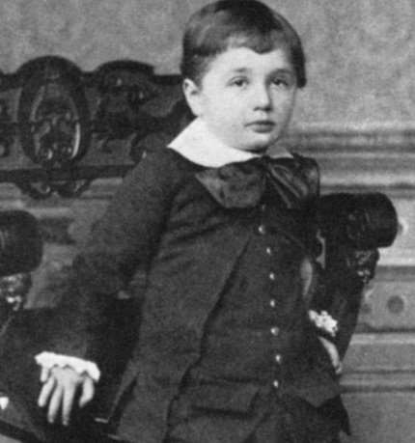
A Truly Beautiful Mind
The story recounts the life of an outstanding scientific personality, Albert Einstein, from his birth, till his death.

Slide 6
A Truly Beautiful Mind
Albert Einstein was born on 14th March in 1879, in the German city of Ulm. For about two and half years he could not speak and when he did learn to speak, he uttered every word twice. His playmates called him “Brother Boring”, and his mother regarded him a freak because of the abnormally large size of his head.

Slide 7
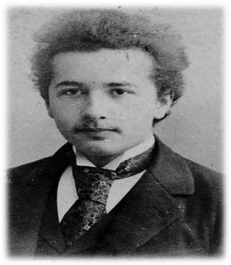
A Truly Beautiful Mind
At school, his Headmaster regarded him as stupid and good for nothing.
But he proved them all wrong.

Slide 8
A Truly Beautiful Mind
At the age of 6, on behest of his mother, he learned to play the violin. He became a gifted violinist. At the age of 15, his family shifted to Munich. He did not feel at ease with the strict regimentation of the school and left it for good. Later on, for higher education, he joined the University at Zurich because the atmosphere there was more liberal and amenable to new ideas and concepts. He showed more interest in Physics and Mathematics.

Slide 9
A Truly Beautiful Mind
• So

Slide 10
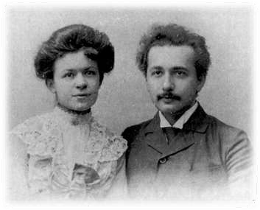
A Truly Beautiful Mind
He met a fellow student, Mileva Marie at the University- equally intelligent and clever. Later on they married and had
2 sons but unfortunately their marriage did not survive and were divorced in 1919.

Slide 11
A Truly Beautiful Mind
After completing his education, Albert worked as a technical expert in the patent office at Bern. Here, he worked secretly of his idea on relativity.
In 1915, he published his paper on special theory of relativity, followed by the world famous equation: E = mc².

Slide 12
A Truly Beautiful Mind
In 1915, he published his paper on General Theory of Relativity, which gave an absolutely new definition to concept of gravity. This theory made him a famous figure.
In 1919, during the solar eclipse, his theory came out to be accurate and revolutionized physics. In 1933, he emigrated to USA as Nazis had come to power in Germany.

Slide 13

A Truly Beautiful Mind
He did not want his finding and research to be used for destruction. In 1938, when Germany discovered the principle of
Nuclear Fission, he was the first person to write to the American President about the dangers of the atomic bombs.

Slide 14
A Truly Beautiful Mind
In 1945, when America dropped the Atomic Bombs on Nagasaki and Hiroshima, he was deeply hurt and wrote to’the United Nations for the formation of a world government to prevent recurrence of such destruction.
He spent his later days in politics advocating world peace and democracy.

Slide 15
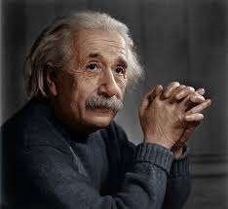
A Truly Beautiful Mind
He died at the age of 76 in the year 1955.

Slide 16
WORDS MEANING
freak: a word used disapprovingly to talk about a person who is unusual and doesn’t behave, look or think like others
regimentation: order or discipline taken to an extreme
liberal: willing to understand and respect others opinions
ally: a friend or an associate
philistines: a word used disapprovingly to talk about people who do not like art,literature or music
patent: a document which gives the rights of an invention to an inventor

Slide 17
WORDS MEANING
unravelling: starting to fail
faltered: became weak
Emigrated: leave one’s own country in order to settle permanently in another
in an uproar: very upset
missive: letter, especially long and official
visionary: a person who can think about the future in an original and intelligent way

Slide 18
A Truly Beautiful Mind Here are some questions to prepare:
Which remarkable incident happened in the life of Einstein in 1921?
How did Einstein react to the bombing of Hiroshima and
Nagasaki?
What did Einstein call his desk drawer at the patent office &
why?
What is Einstein’s special theory of relativity?
Why did Einstein play with himself in his childhood?
Why does the world remember Einstein as a ‘World citizen’?

